Slide 1
Machine Learning Project on Doge Coin
By,
Jathin
Udith
Tejas
Yogeshwar

Slide 2
Introduction
Our dataset deals with the cryptocurrency Doge Coin. The dataset provides the history of daily prices of Dogecoin.
It is used to predict the peak value the coin has attained on a particular date.
Project is based on continuous value therefore we use regressive models.
5 feature vectors that is Date, Open, Close, Low and High.
Target attribute is High.

Slide 3
Models Applied
K Nearest Neighbour
Single Layer Perceptron
Multi Layer Perceptron
Support Vector Machine
Decision Tree
Naïve Bayes
Linear and Logistic Regression
Bayesian Ridge
Lasso Regression
Ransac Model
Least Angle Regression
Elastic Net Regression

Slide 4
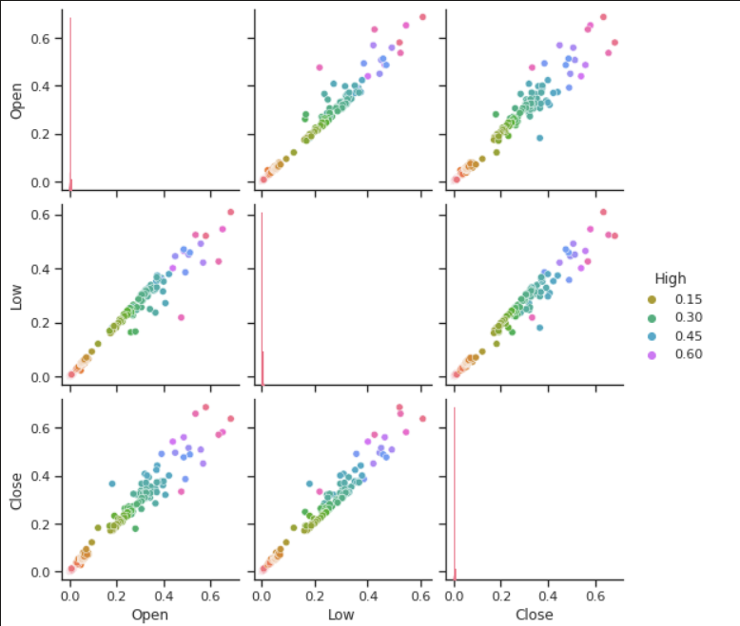
K Nearest Neighbour
Single Layer Perceptron
Time taken to execute:
0.010796308517456055
Accuracy of the model:
0.9897475051327284
Time taken to execute:
0.022917747497558594
Accuracy of the model:
0.436343056884857

Slide 5
Multi Layer Perceptron
Support Machine Vector
Time taken to execute:
0.4707198143005371
Accuracy of the model:
0.5
Time taken to execute:
3.2820651531219482
Accuracy of the model:
0.19783740488586304

Slide 6
Elastic Net Regression
Naïve Bayes
Time taken to execute:
1.1494791507720947
Accuracy of the model:
[0.02830641 0.02660016 0.02483349 0.03525707 0.0203132 0.02905556 0.02437812 0.02506153 0.02657257 0.02850101 0.02524004 0.02485035 0.02632915 0.02818223 0.0260482 0.02603803 0.03288961 0.02699156 0.02983201 0.02234394 0.0254619 0.02864341 0.02757634 0.023456 0.02536347 0.02523936 0.02651263 0.02761587 0.0277643 0.03114915]
Time taken to execute:
0.03266143798828125
Accuracy of the model:
0.9527432919503404

Slide 7
Linear Regression
Logistic Regression
Time taken to execute:
0.0038633346557617188
Accuracy of the model:
0.9687717804910521
Time taken to execute:
0.08988499641418457
Accuracy of the model:
1.0

Slide 8
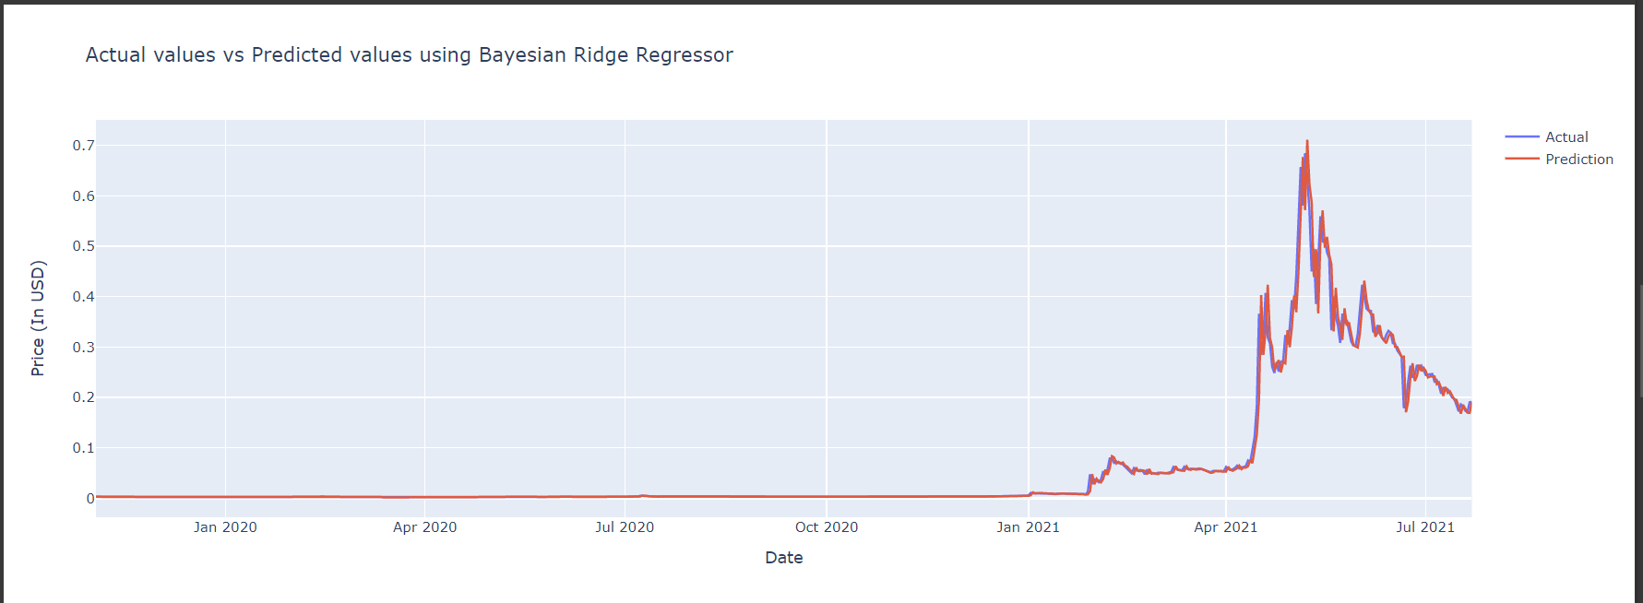
Bayesian Ridge
Lasso Regression
Time taken to execute:
0.007124185562133789
Accuracy of the model:
0.9744005772272885
Time taken to execute:
0.07085776329040527
Accuracy of the model:
0.9962011530488094

Slide 9
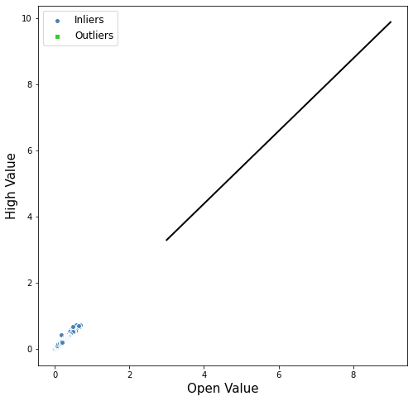
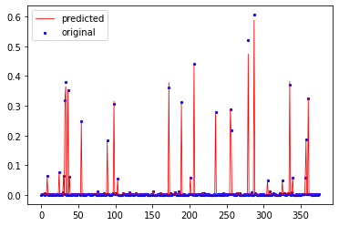
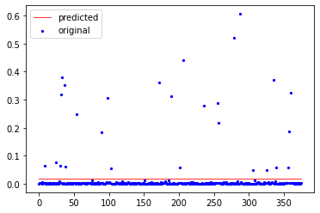
Ransac
Least Angle Regression
Time taken to execute:
0.019782543182373047
Accuracy of the model:
0.9849955662382477
Time taken to execute:
0.39669370651245117
Accuracy of the model:
0.996561934166805

Slide 10
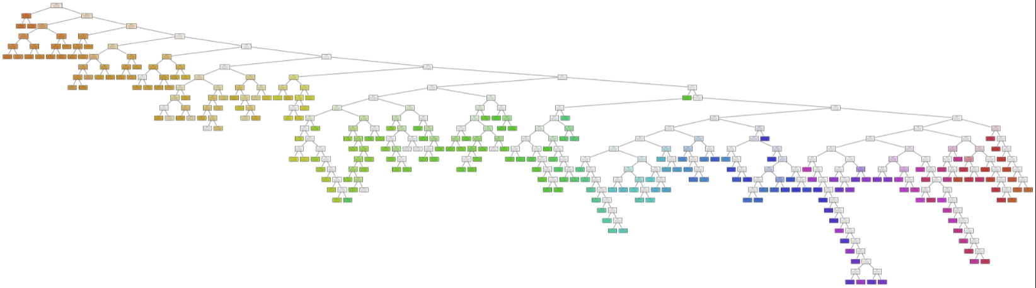
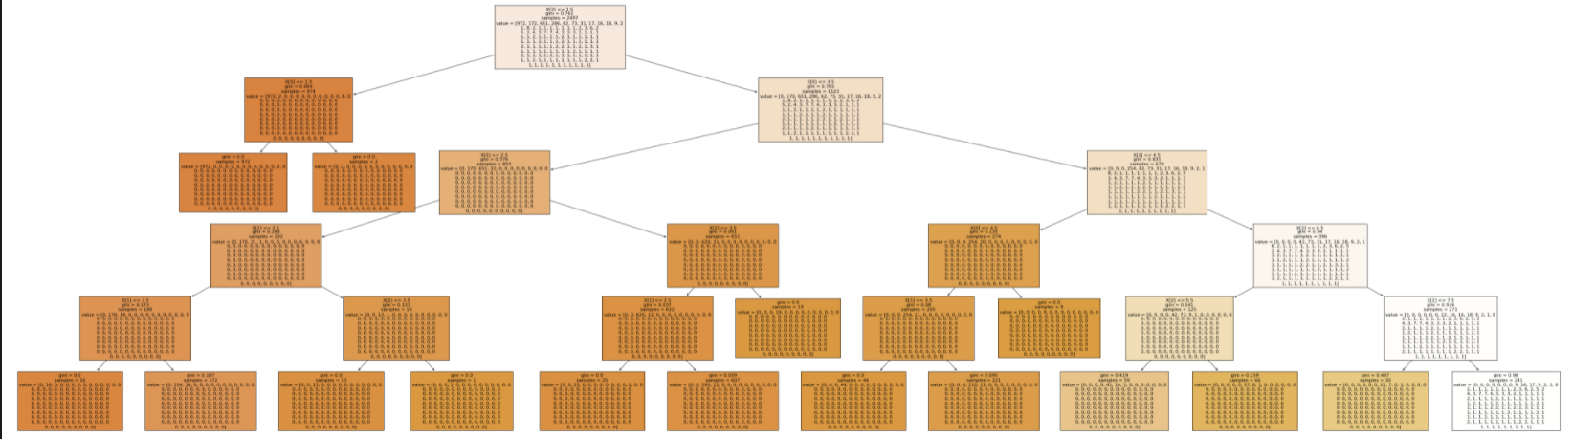
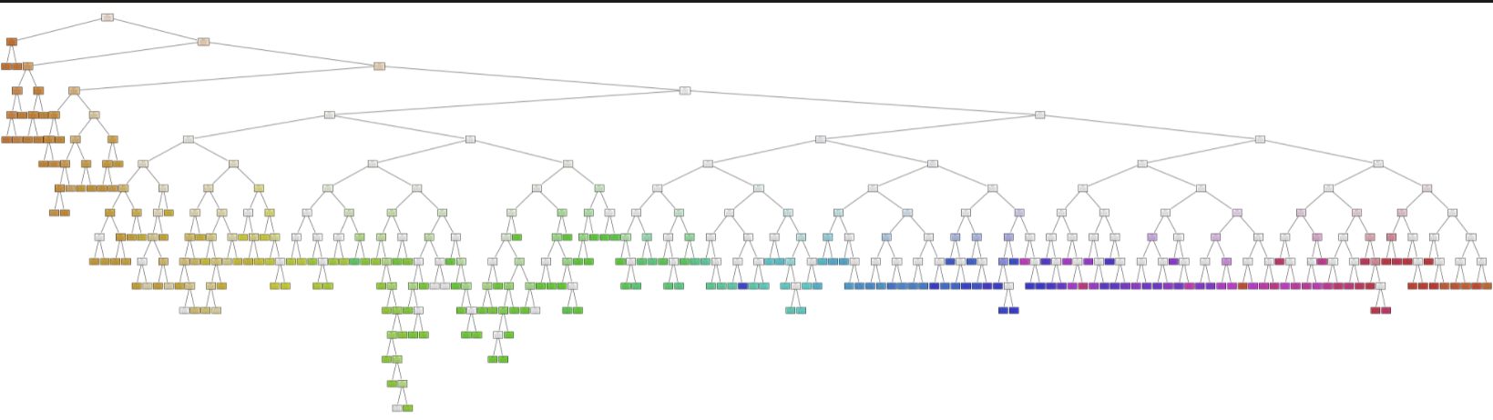
Decision Tree
Time taken to execute:
0.9719663596315579
Accuracy of the model:
0.9719663596315579

Slide 11
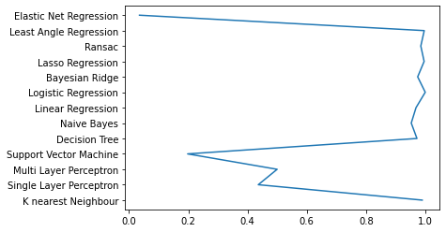
Accuracy Comparisons

Slide 12


